Slide 1



Text-mining for Cohort Ascertainment and Analysis of Patients with EVA
E. Bryan Crenshaw III, PhD
Center for Childhood Communication
The Children’s Hospital of Philadelphia
Dept. of Otorhinolaryngology: Head & Neck Surgery
Perelman School of Medicine at the University of Pennsylvania
Principal Investigator, AudGenDB Project

Slide 2
Acknowledgements
CHOP
John Germiller, MD PhD (Oto)
Joy Peterson, AuD (Audiology)
Ian Krantz, MD (Genetics)
Biomedical Informatics
Jeff Pennington (Lead)
Byron Ruth (Web Architect)
Jeff Miller (Imaging)
Aaron Masino (Machine Learning)
Data Science & Biostatistics
Lezhou “Joe” Wu, MPH
Ying Cui, MPH
Baichen Xu, MPH
Research Audiologists
Faith Sikorski, AuD
Danielle Leisner, AuD
Vanderbilt
Linda Hood, PhD (Sub-PI, Audiology)
Jordan Racca (Audiology)
Jana Shirey-Rice (IT)
Boston Children’s Hospital
Margaret Kenna, MD (Sub-PI, Oto)
Tamar Gomes, AuD (Audiology)
Derek Stiles, PhD (Audiology)
Julie Edwards (CRC)
Juliana Manganella (CRC)
External Advisory Board
J. Richard Landis, PhD, (Biostats)
Albert H. Park, MD (Oto)
Beth A. Prieve (Audiology)
Christine Yoshinaga-Itano, PhD (Audiology)

Slide 3
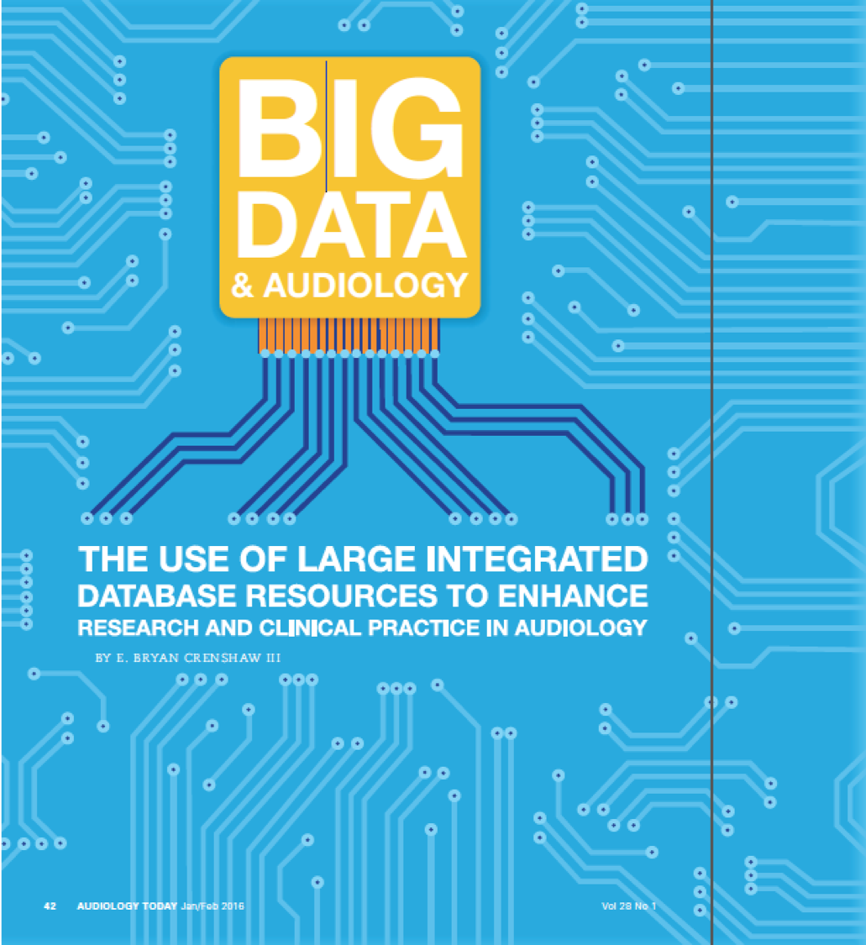
Big Data & Audiology
Audiology Today, 28:42-49 (2016)

Slide 4
Big Data: Opportunities & Challenges
Provides opportunities
Large cohort sizes
Comparison across institutions
Compendium of data resources to bring to bear on a problem
Rapid testing of hypotheses
Presents Challenges
Observational studies
Sparsity of data
Significant amounts of data in the form of text, which isn’t readily accessible to computational methods without further work

Slide 5
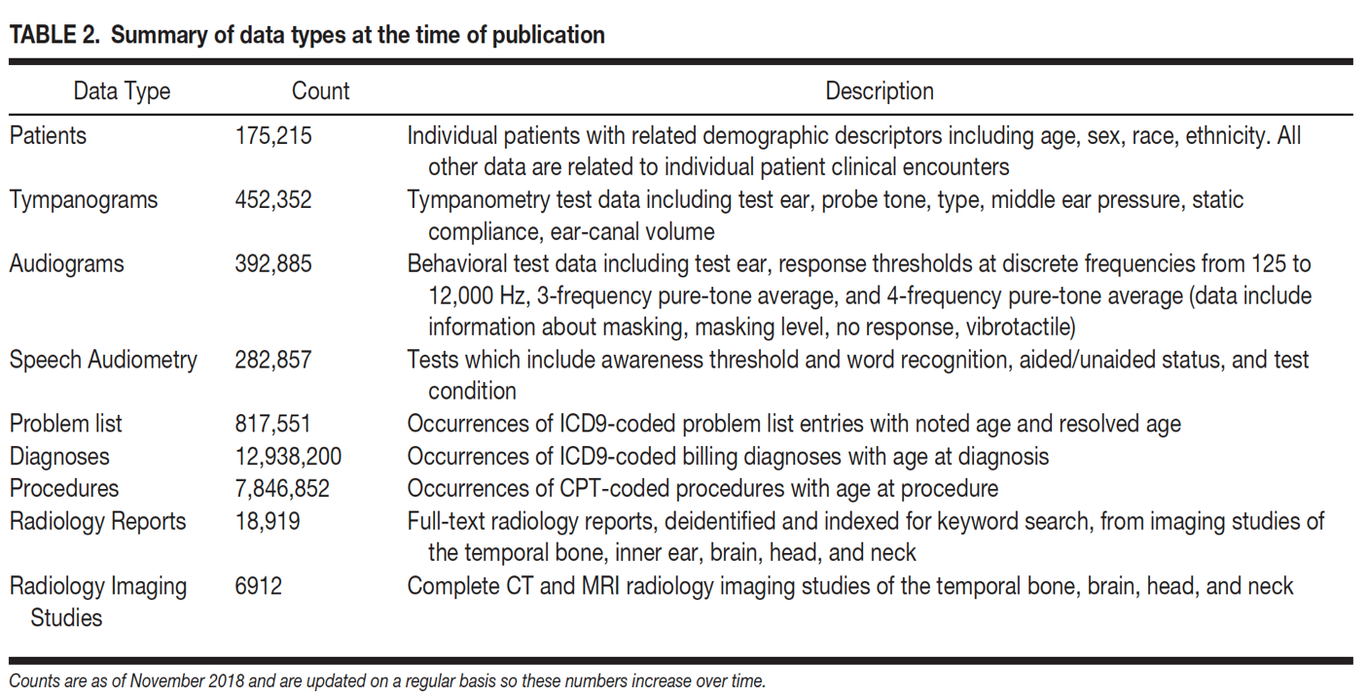
The Audiological and Genetic Database (AudGenDB)
Pennington et al., 2019

Slide 6
Hearing Loss Progression
The larger question – Enlarged Vestibular Aqueduct (EVA) is a subset of the HL Progression problem
How to determine which patients will progress?
Can machine learning techniques be used to predict HL progression?
What computational approaches can we bring to bear on the problem?
What features are available for inclusion as features in machine learning techniques?
Can we generate ‘computed phenotypes’?

Slide 7
Identifying an EVA Cohort
No unique ICD Code
How to identify the cohort?
Track in the clinic (Approach Taken at Boston Children’s & Vanderbilt)
Text Mining Radiology Reports (CHOP Approach)
Radiology Reports are ‘Semi-Structured’
Organization is stereotyped
Language is idiosyncratic for each clinician
(Some believe verbosity is elegant ;-)

Slide 8
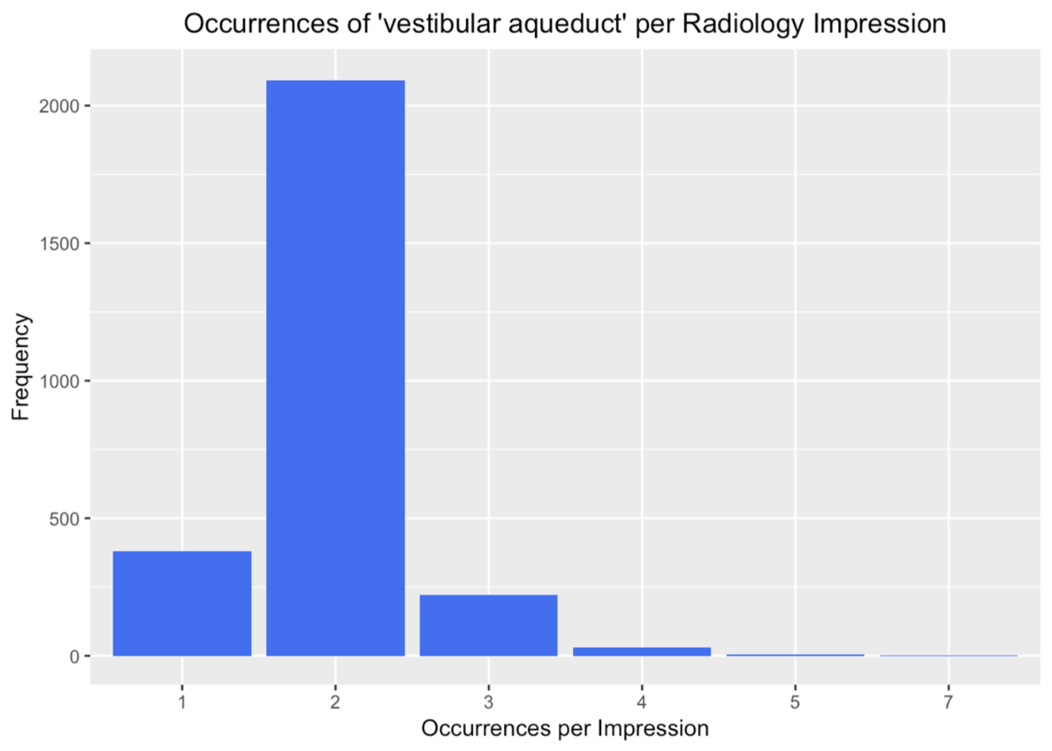
Text Mining for the Term ‘vestibular aqueduct’

Slide 9
Text Mining for the Term ‘vestibular aqueduct’
18,919 radiology impressions in AudGenDB
2726 observations can be found with the term, ’vestibular aqueduct`
256 impressions have the term more than twice
Hand-curated 30 of these
21 describe EVA
2 definitely not enlarged
5 used radiology CYA words (ambiguous)
1 duplicate report
1 thin vestibular aqueduct
A list of specific terms assembled

Slide 10
Text Mining: Regular Expressions
Dispositive Expression (5):
Example: (vestibular(\\n| )aqueducts?.+(is|are|with)(\\n| ) ?(mildly|markedly)?(\\n| )(enlarged|dilated|widened))
Exclusionary Expression – Negative (13):
Example: no( |\n)evidence of enlarg(ed|ement of the) vestibular aqueducts?
Exclusionary Expression – Ambiguous (4):
Example: may represent\nenlarged vestibular aqueducts
Notes:
10

Slide 11
Text Mining: Regular Expressions
18,919 radiology impressions in AudGenDB
6,255 patients
206 impressions from 190 patients are found using the regex algorithms
344 patients cumulatively at the three institutions represented in AudGenDB

Slide 12
Computational Methods to Identify HL Progression
Most in the audience familiar with identifying HL progression using a collection of audiograms from a single patient
Our task was to develop computational methods that could screen ~400,000 audiograms in AudGenDB from ~136,000 patients
Given the large number of audiograms, we had one luxury: making a rigorous definition
Our definition: Using masked bone thresholds, find patients whose PTA4 dropped by 10 dB from first to last hearing test.

Slide 13
HL Progression in AudGenDB
135,706 total patients with audiograms in AudGenDB
15,581 patients fitting inclusion criteria using masked bone conduction.
Inclusion Criteria: Patients must have at least 3 hearing tests that dropped by 10 dB HL or more from first to last hearing test that were tested at 4 frequencies (500, 1000, 2000, and 4000 Hz).
390 patients with HL progression defined by these criteria

Slide 14
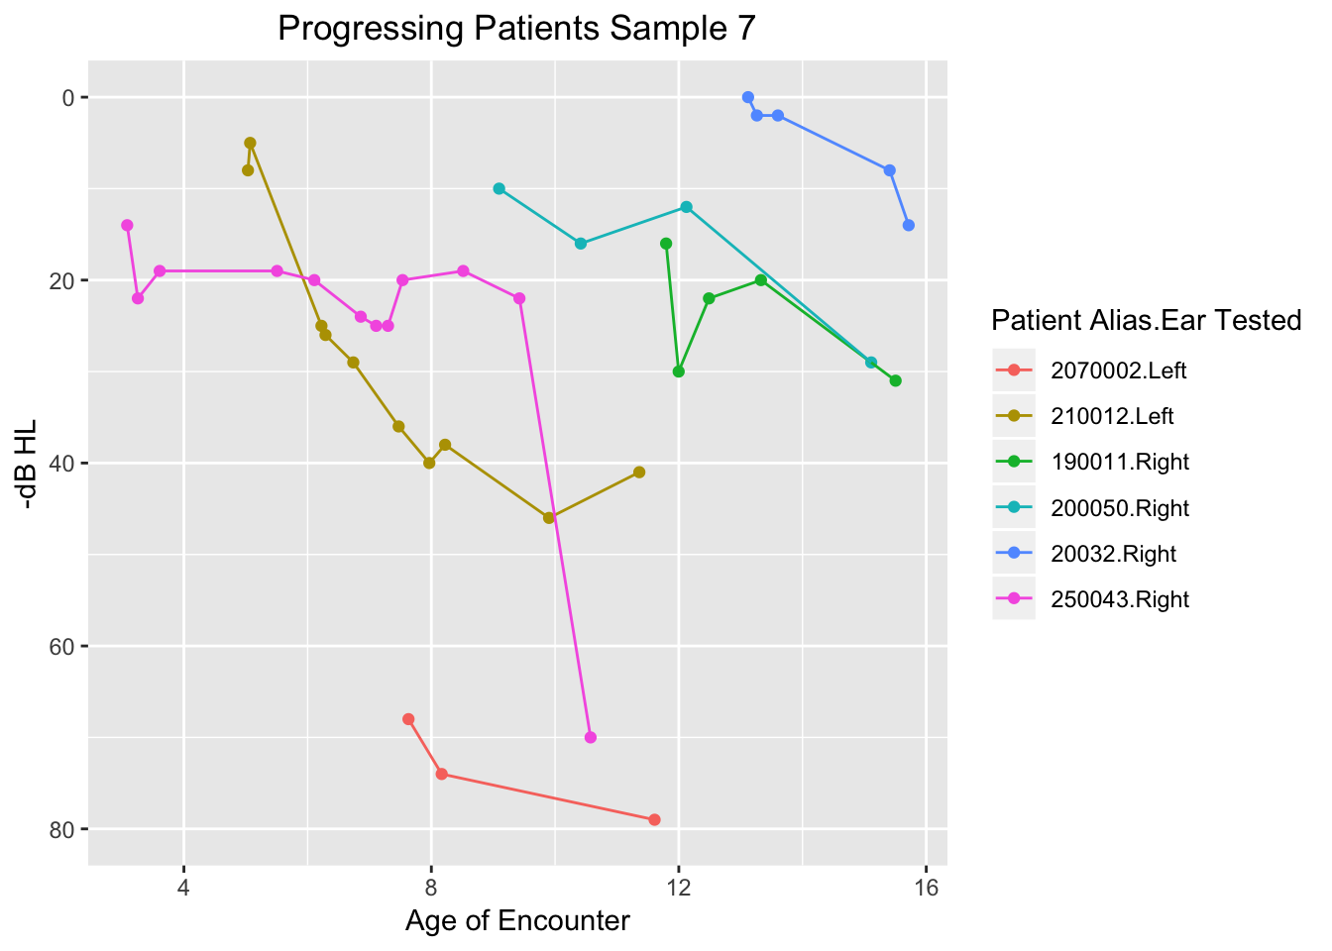
Sample of Patients Demonstrating HL Progression
PTA4 ~ Age (years)
Notes:
Graph from < file:///Users/ebciii3/Public/AudGenDB%20Data%20Mining/Hearing%20Loss%20Progression/html/TemporalGraphsHLprogressionCohort.html#data_analysis > HL103 Temporal Graphs of HL Progression Cohort

Slide 15
HL Progression in EVA Patients
Changed definition: Using air conduction thresholds, find patients whose PTA4 dropped by 10 dB from first to last hearing test.
For routine monitoring of EVA patients, air conduction thresholds were typically measured
155 patients (of the 190 found at CHOP) have enough audiogram data for analysis (at least 3 audiograms with all PTA4 frequencies included)
60 EVA patients demonstrated progressive hearing loss
39% of the qualifying EVA patients have progressive hearing loss

Slide 16
Identifying Patients with Fluctuating Hearing
Approach: Calculate difference in PTA 4 from test to test as the patient ages
Definition: Maximum >= 10 dB between tests & minimum <= -10 dB between tests
In other words, test-to-test change must go up at least 10 dB and drop by at least 10 dB
Results
190 total CHOP patients with EVA
155 patients meet all inclusion criteria using air conduction for testing
71 ears from 60 patients showed progression demonstrated progressive hearing loss
36 ears that qualify as fluctuating in the entire data set
19.9% of the hearing tests
13 ears with fluctuating hearing thresholds among the progressive HL patients

Slide 17
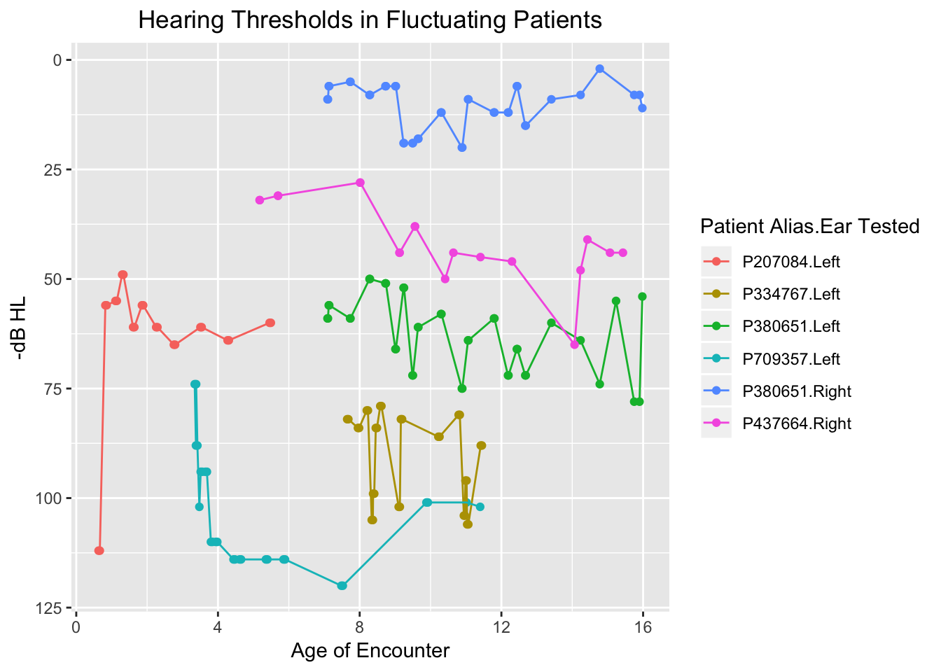
Examples of Fluctuation in EVA Patients

Slide 18
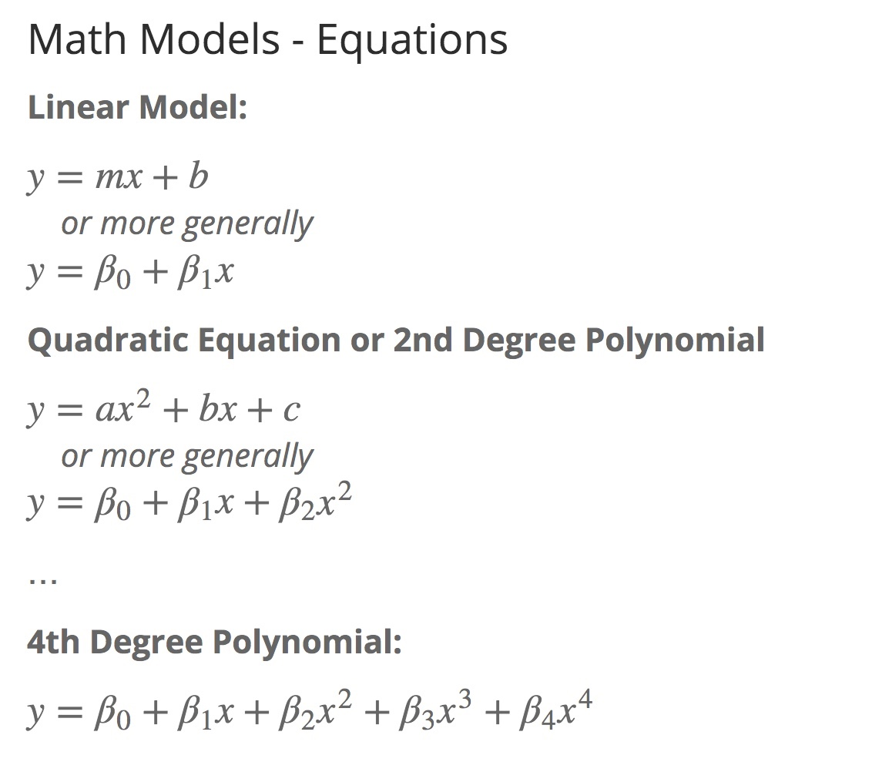
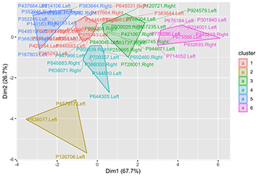
Mathematical Modeling to Identify Progression Types
Sudden hearing loss is a prominent feature of HL Progression
Can we use mathematical modeling to categorize HL Progression profiles?
Model each patient's pta4 ~ age curve
Extract variable values
linear (m/β1, b/β0, r²)
4th order polynomial (β4, β3, β2, β1, β0, r²)
Clustering

Slide 19
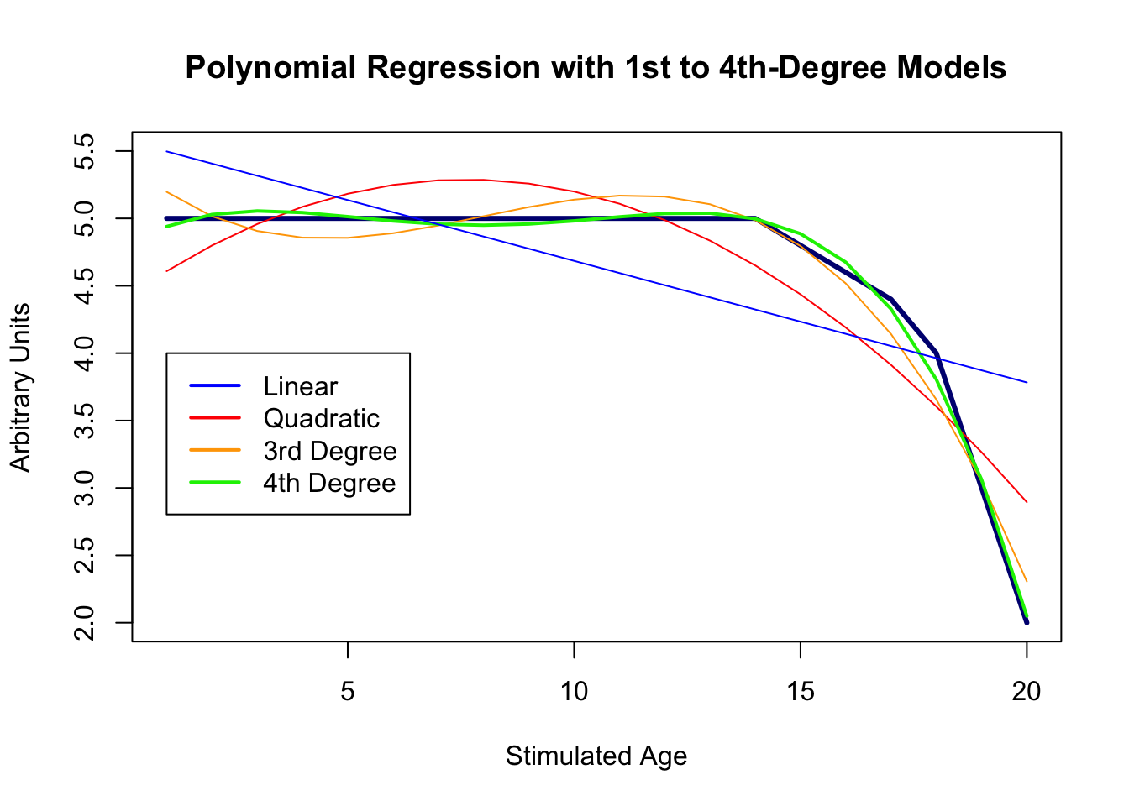
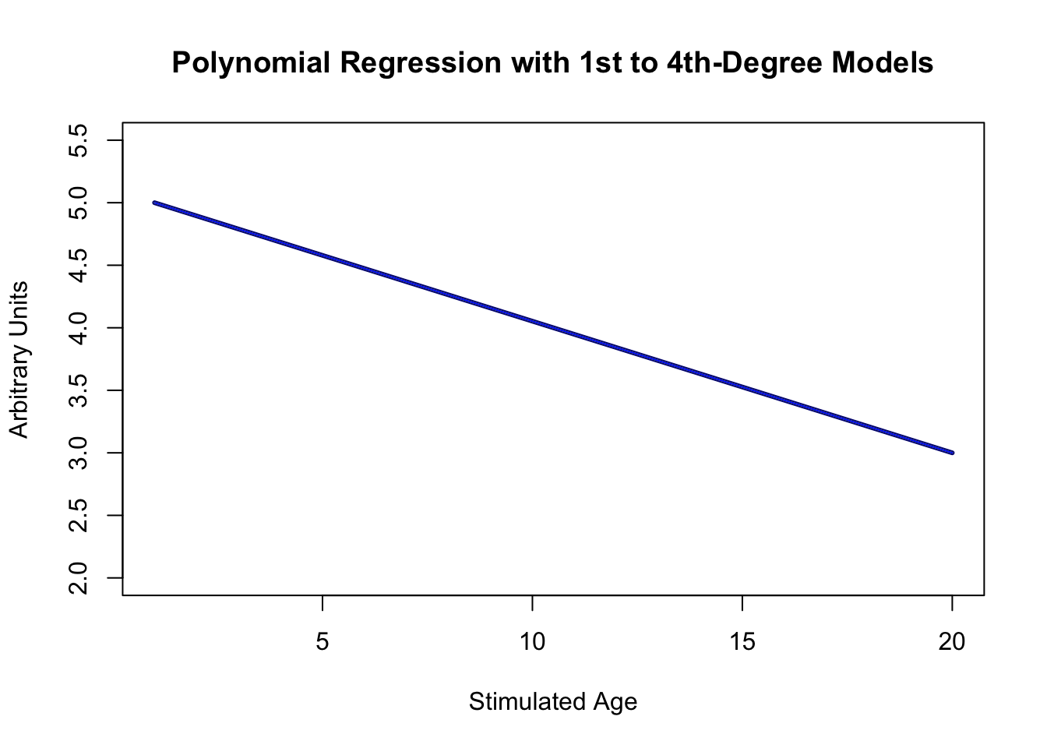
Mathematical Modeling: Theoretical Curves
Sudden Hearing Loss (black line) is best modeled with 4th degree polynomial
Linear model fits the data poorly (blue line), which is reflected in a low r² value
4th order polynomial model fit is good (green line), and r² value is high
Slow HL Progression is well-modeled with both linear and polynomial approaches
Linear model fit is good and r² value is high
4th order polynomial is good, and r² value is high (all models fit perfectly, and therefore overlap)

Slide 20
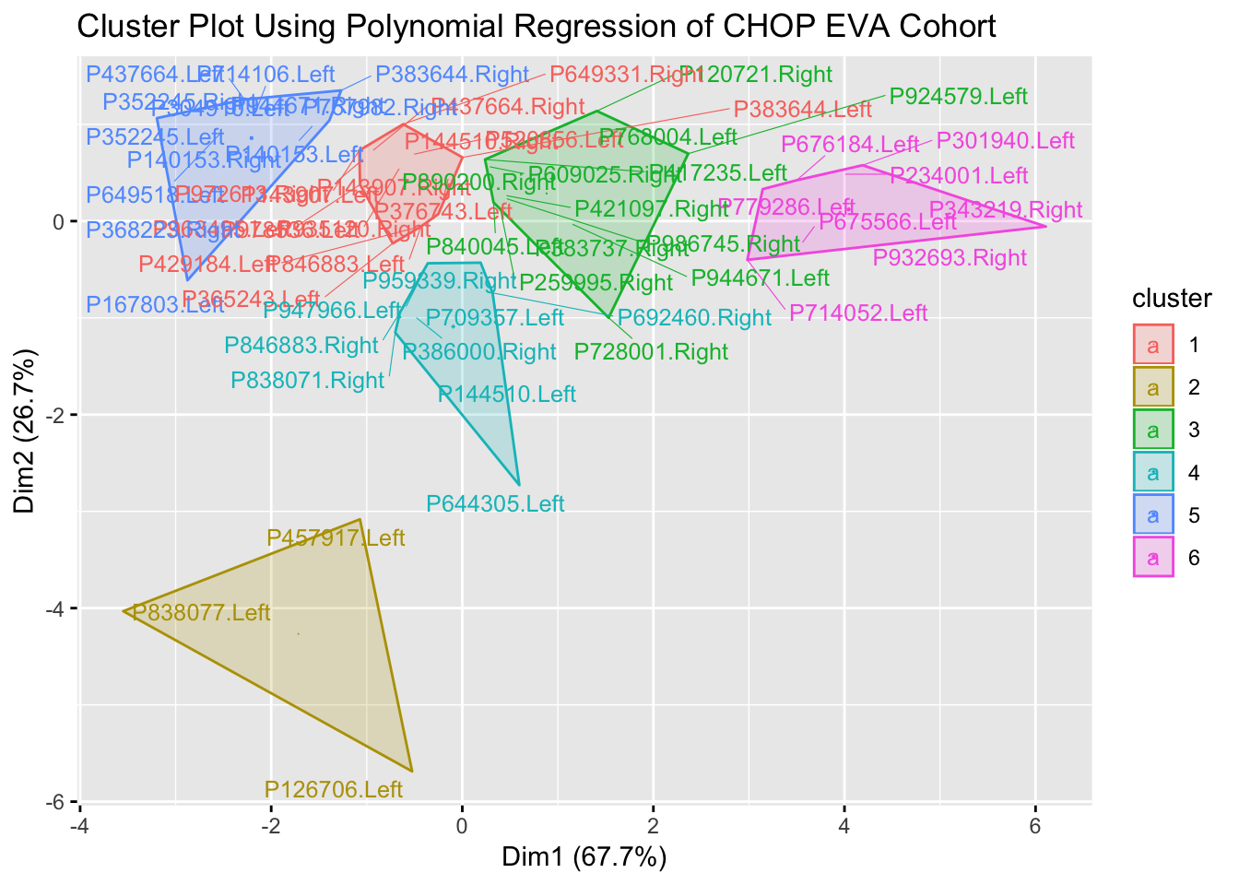
Clustering HL Progression Profiles (PTA4 ~ Age)
Clustering of Models Can Generate Useful Categorization of HL Progression

Slide 21
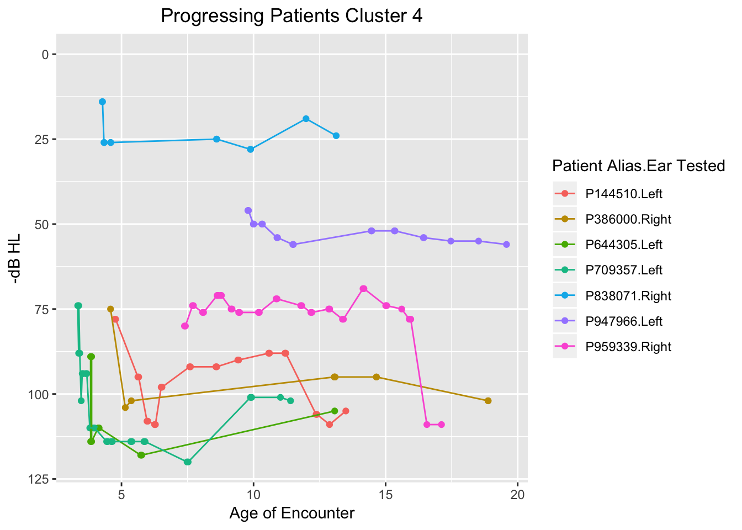
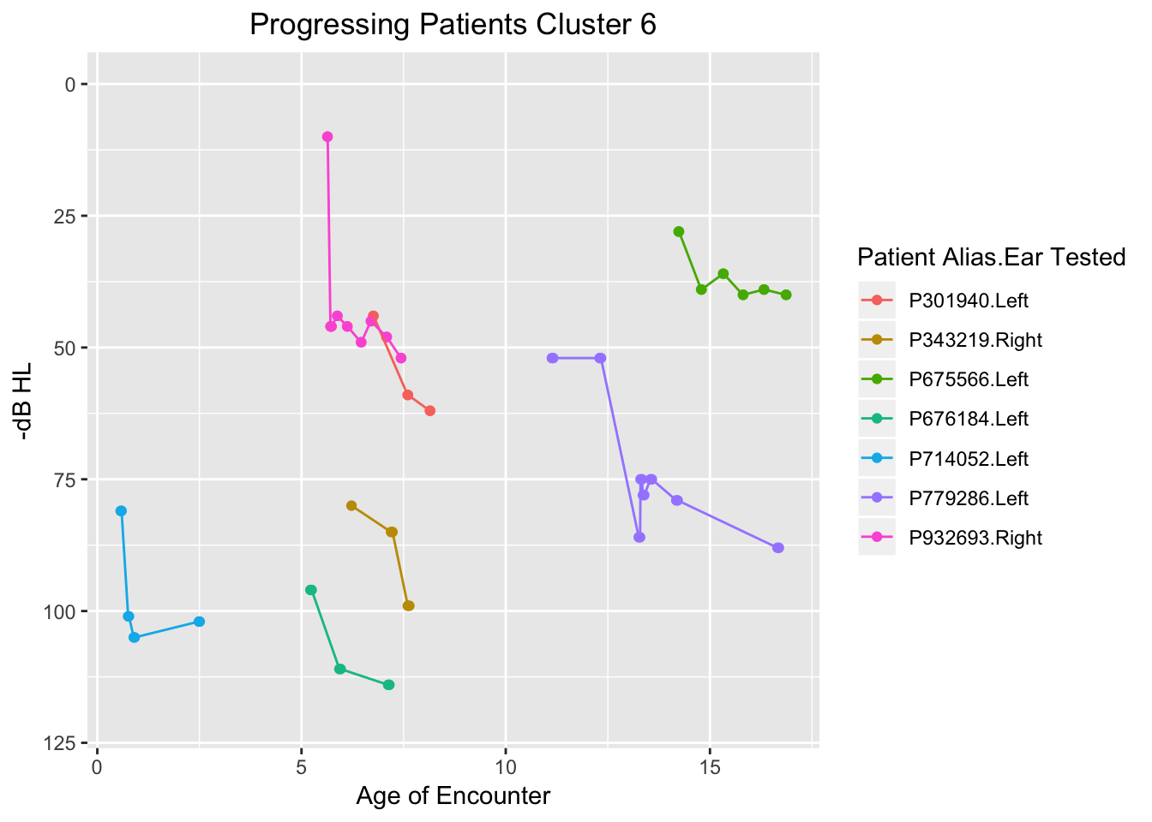
Two Categories of Sudden Hearing Drop Profiles Distinguished by Clustering: CHOP EVA Cohort
Sudden Drops In An Overall Stable Profile
Sudden Drops Without an Otherwise Stable Profile

Slide 22
Conclusions
Big Data in hearing sciences requires development of new computational methods to characterize hearing data
Text mining approaches can be used to identify patient cohorts that have traditionally taken considerable effort to find
Algorithms have been developed to identify temporal patterns in hearing tests relevant to hearing research, such as HL progression and fluctuation
These approaches can digest large datasets, and provide ‘features’ for machine learning
In the long term, predictive analytical techniques using these approaches can be developed
Clinical decision support (CDS) systems can then incorporate predictive analytic models to facilitate the evaluation of patients in audiological and otolaryngological practices

Slide 23
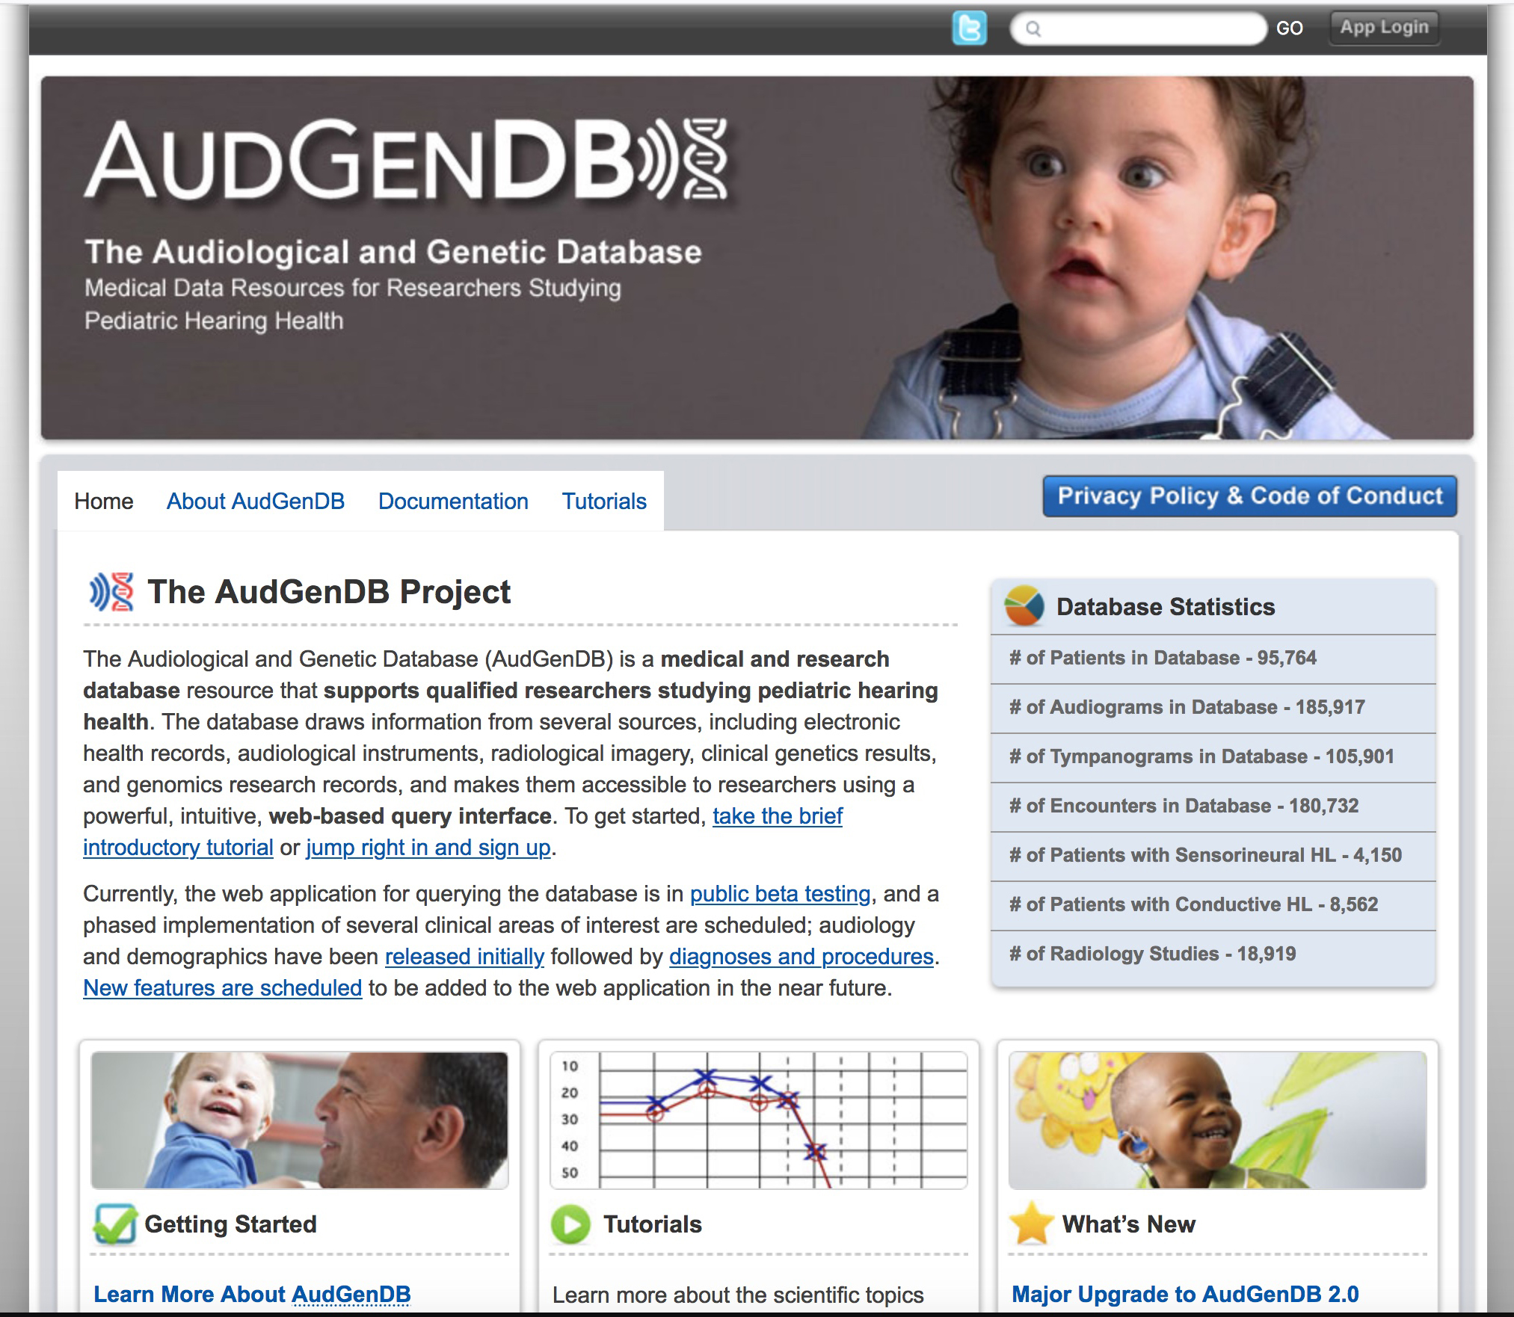
AudGenDB Home Page
AudGenDB website is found at https://audgendb.chop.edu/.

Slide 24
Questions?

Slide 25
The Audiological and Genetic Database (AudGenDB)
Pediatric hearing research integrates complex data from varying specialties, on large numbers of patients.
Examples of data in AudGenDB:
Audiogram for hearing thresholds
Evoked responses (e.g. ABR)
Speech and language performance
Diagnoses and problems
Procedures
Temporal bone imaging
Large-scale hearing research projects would benefit from an integrated electronic database that incorporates these varied data.

Slide 26
Distribution of Patients in AudGenDB
Color Scheme: CHOP Blue, Harvard (BCH) Crimson,
and Vanderbilt Commodore Gold.
Notes:
26

Slide 27
Data Science – Machine Learning
AudGenDB Advantage – Massive Amounts of Data
AudGenDB Disadvantage – Massive Amounts of Data
Difference: Structured vs. Unstructured Data
Unfortunately, Much Unstructured Clinical Data
How Do We Sort Out Unstructured Data?
Manual Curation – Time & Labor Intensive
Machine Learning – Accuracy?

Slide 28
Talk Outline
Work in Progress
Demonstrate textmining approaches
Discuss algorithms to identify progression
Discuss mathematical modeling to facilitate our analyses
Touch on how these approaches facilitate the long term goal of predictive analytics

Slide 29
Mathematical Modeling to Identify Progression Types

